Slide 2
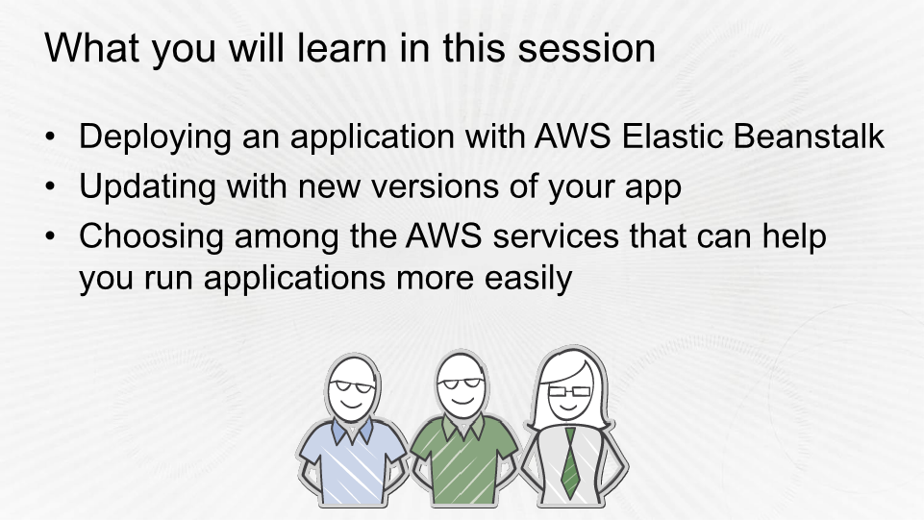

Slide 3
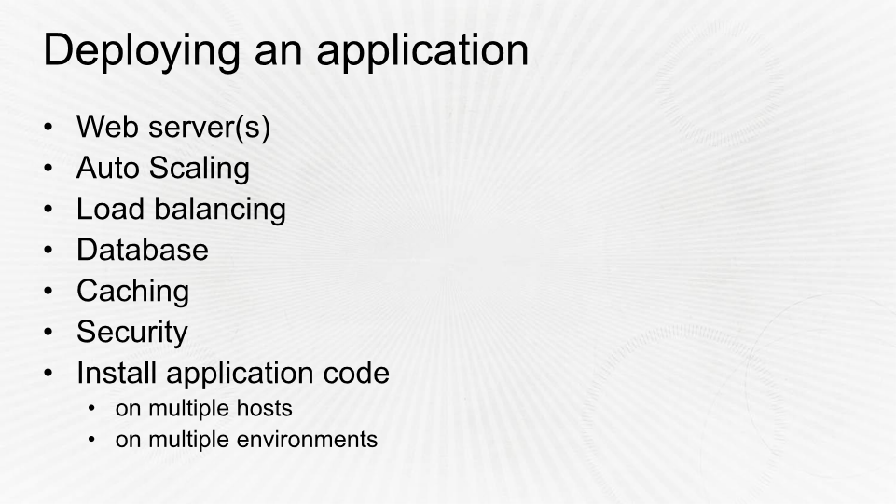













Amazon Route 53
DNS service
www.example.com
Elastic Load
Balancing
S3 bucket for
static assets
ElastiCache
node 1
RDS DB
instance
RDS DB
standby
ElastiCache
node 2
Availability Zone a
Availability Zone b

Slide 4
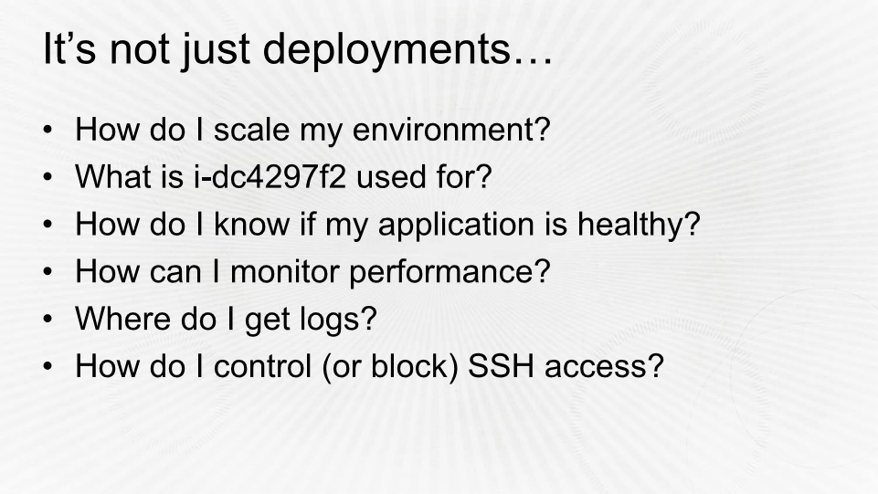

Slide 5
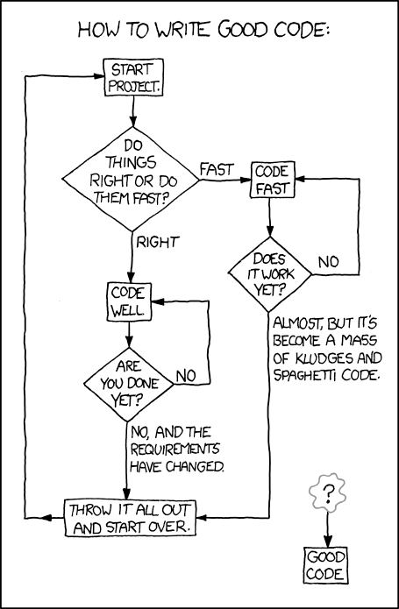
You need to
deliver resilient
applications with
less work
Source: http://xkcd.com/844/

Slide 6
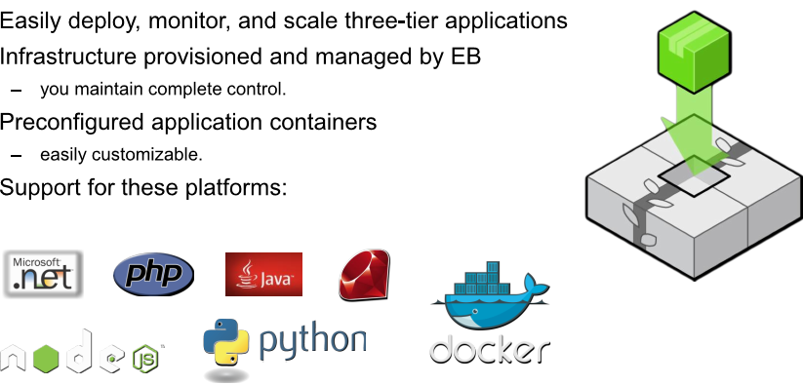
AWS Elastic Beanstalk (EB)

Slide 7
Benefits of Elastic Beanstalk
Focus on your application
Focus on what makes your business unique
Focus on innovation, not undifferentiated heavy lifting
Spend developer time in the right place
Automate as much as you can

Slide 8
There’s no additional charge for
Elastic Beanstalk

Slide 9


Elastic Beanstalk object model
Application
Environments
Application versions
Saved configurations
• Infrastructure resources
(such as EC2 instances,
ELB load balancers, and
Auto Scaling groups)
• Application code
• Configuration that defines
how an environment and its
resources behave
• Stored in Amazon S3
• An application can have
many application versions
(easy to rollback to previous
versions)
• Can be used to launch new
environments quickly or roll-
back configuration
• Runs a single application
version at a time for better
scalability
• An application can have
many saved configurations
• An application can have
many environments (such
as staging and production)

Slide 10

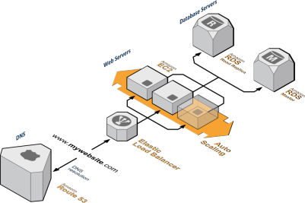
Elastic Beanstalk environment
• Two types:
• Single instance
• Load balancing, auto scaling
• Two tiers (web server and worker)
• Elastic Beanstalk provisions necessary
infrastructure resources such as load
balancers, auto-scaling groups, security
groups, and databases (optional)
• Configures Amazon Route 53 and gives
you a unique domain name
(For example: yourapp.elasticbeanstalk.com)

Slide 11



On-instance configuration
Focus on building your
application
Your code
HTTP server
•
Elastic Beanstalk configures
each EC2 instance in your
environment with the
components necessary to
run applications for the
selected platform
Application server
Language interpreter
Operating system
•
No more worrying about
logging into instances to
install and configure your
application stack
Host

Slide 12
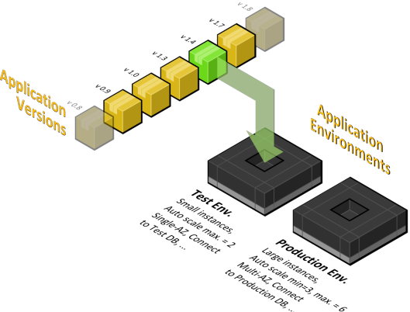

Application versions
saved configurations
Application versions
All versions are stored durably
in Amazon S3. Code can also
be pushed from a Git repository!
Saved configurations
Save these for easy duplication for
A/B testing or non-disruptive
deployments

Slide 13






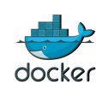
Java
PHP
Python
Ruby
.NET
Node.js
Docker

Slide 14







Slide 15





Slide 16












http://your-app.elasticbeanstalk.com
Alert
ELB
Log
App
Mon
AZ

Slide 17







http://your-app.elasticbeanstalk.com
Alert
Log
App
Mon
AZ

Slide 18



http://your-app.elasticbeanstalk.com
Alert
ELB
Log
App
Mon
AZ

Slide 19





Producers
SQS queue
Alert
Log
App
AZ
Mon

Slide 20

Developer workflow

Slide 21
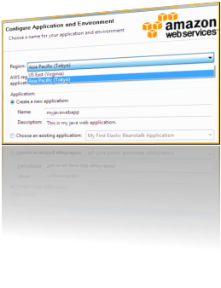
Deployment options
1. Via the AWS Management Console
2. Via Git / EB CLI
$ git aws.push
3. Via the AWS Toolkit for Eclipse and the
Visual Studio IDE

Slide 22










Deployment configuration
Your code
01
Region
02
Stack (container) type
Load balanced with
Auto Scaling
03
Single instance
OR
04
Database (RDS)
Optional

Slide 23


Example: CLI workflow
•
AWS account
– your
access and secret
keys
•
EB CLI
Linux
•
•
/
Unix
/
Mac: Python 2.7 or 3.0
Windows PowerShell 2.0
•
A credential
file
•
Git 1.66 or later (optional)

Slide 24
Example: CLI workflow
01
Initialize your Git repository
04
Add your code
$ git init .
$ git add .
02
Create your Elastic Beanstalk app
05
Commit
$ eb init
$ git commit –
m
“v1.0”
Follow the prompts to configure the
environment
Create the resources and launch the
application
03
06
$ eb create

Slide 25

Example: CLI workflow
01
Update your code
02
Push the new code
$ git add .
$ git commit –m “v2.0”
$ eb deploy
03
Monitor the deployment progress
$ eb status

Slide 26
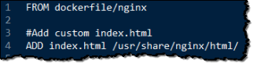
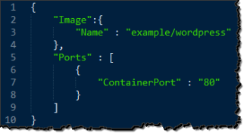
Example: Deploy Docker container to EB
Dockerfile
Dockerrun.aws.json

Slide 27
Example: Deploy Docker container to EB
Initialize your Git repository
Add your code
01
04
$ git init .
$ git add Dockerfile
Create your Elastic Beanstalk app
Commit
02
05
$ eb init
$ git commit –am “v1.0”
Create the resources and launch the
application
Follow the prompts to configure the
environment and copy Dockerfile
03
06
$ eb create

Slide 28


Slide 29
Zero-downtime deployments
Rolling Deployments
1.
2.
EB detaches batch from ELB, Connection draining, Health Checks
EB reattaches batch to ELB and moves to next group of instances
Swap URLs
1.
2.
3.
Create a new environment for an existing application
Deploy your updated application code to the new environment
Use the “Swap URLs” feature to transition users to the new
production environment

Slide 30
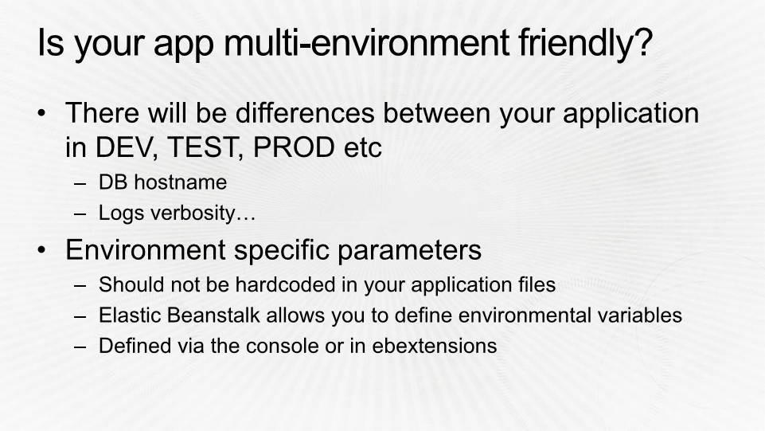

Slide 31




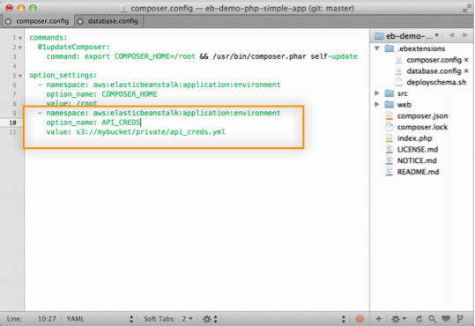











http://your-app.elasticbeanstalk.com
Python
import os
some_var=os.environ.get(‘API_CREDS’)
Alert
Java
String some_var =
System.getProperty(‘API_CREDS’)
ELB
Log
C#
C#
NameValueCollection appConfig =
ConfigurationManager.AppSettings;
App
Mon
string param = appConfig[”API_CREDS"];
AZ

Slide 32
Customize application containers
Add custom software to your environment using ebextensions:
packages:
yum:
newrelic-sysmond: []
rpm:
newrelic: http://yum.newrelic.com/pub/newrelic/el5/i386/newrelic-repo-5-3.noarch.rpm
commands:
0_newrelic_command:
command: "touch /tmp/$(date '+%F.%T.%N').newrelic_command_0"
1_configure_new_relic_key:
command: nrsysmond-config --set license_key=<Your key here>
1a_newrelic_command:
command: "touch /tmp/$(date '+%F.%T.%N').newrelic_command_1a"
2_start_new_relic:
command: "/etc/init.d/newrelic-sysmond start"
2a_newrelic_command:
command: "touch /tmp/$(date '+%F.%T.%N').newrelic_command_2a"

Slide 33
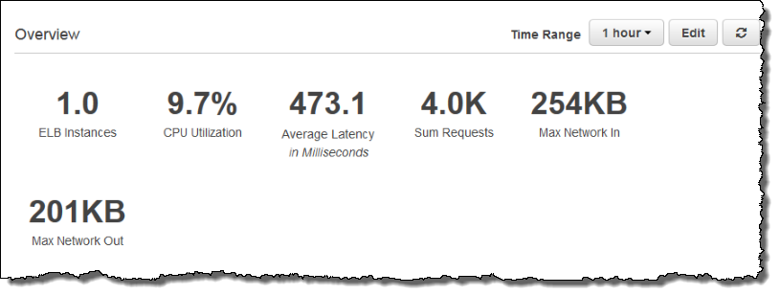
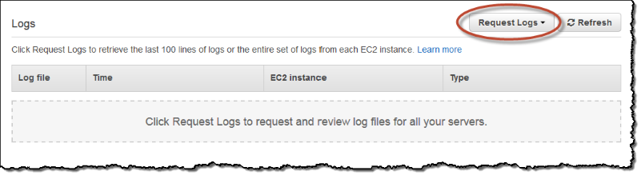

Slide 34
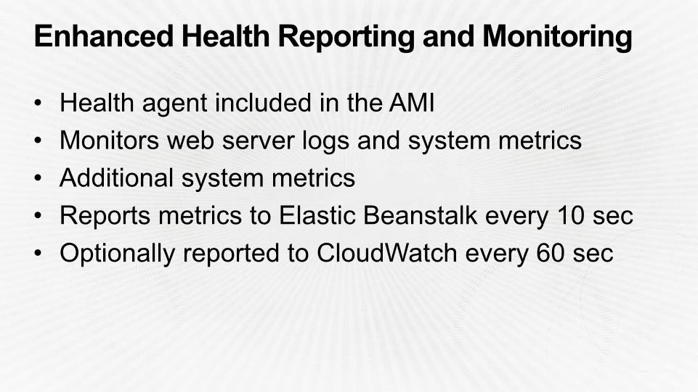

Slide 35
Iterate on application architecture
Add additional resources to your environments using ebextensions:
Add other components such as:
Resources:
MyElastiCache:
Type: AWS::ElastiCache::CacheCluster
Properties:
CacheNodeType:
Fn::GetOptionSetting:
OptionName : CacheNodeType
DefaultValue: cache.m1.small
NumCacheNodes:
Fn::GetOptionSetting:
OptionName : NumCacheNodes
DefaultValue: 1
Engine:
Fn::GetOptionSetting:
OptionName : Engine
DefaultValue: memcached
In
memory caching (Amazon
ElastiCache Redis and
Memcached)
•
-
•
Amazon SQS
•
Amazon CloudFront
Or use CloudFormation => assets independent of environment life time.

Slide 36
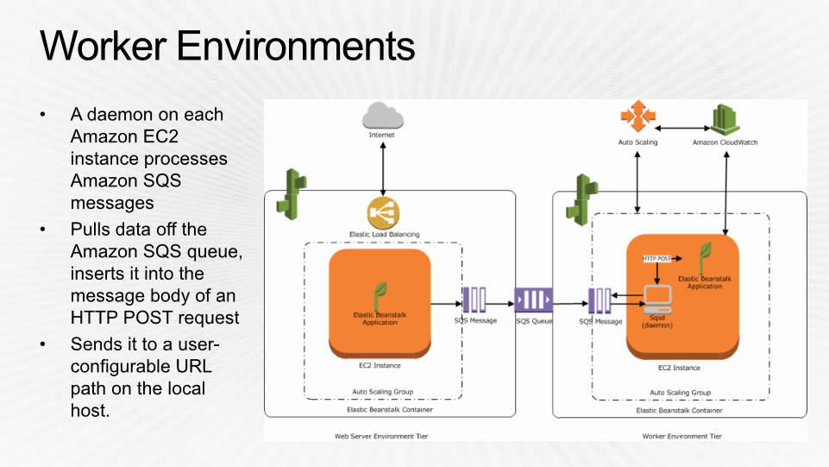

Slide 37
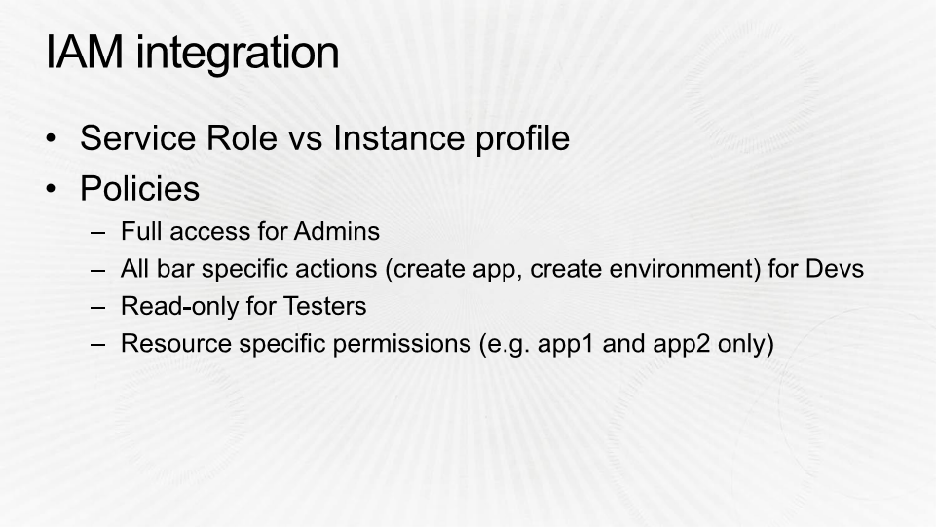

Slide 38


Slide 39



Application container
Application automation
Templated provisioning
Elastic Beanstalk
OpsWorks
CloudFormation

Slide 40



AWS Code services
CodeCommit
CodePipeline
CodeDeploy

Slide 41
Code
Build
Test
Deploy
Provision
Monitor
Elastic Beanstalk
Code
Commit
Code
Pipeline
OpsWorks
Code
Deploy
Cloud
Formation
Cloud
Watch

Slide 42
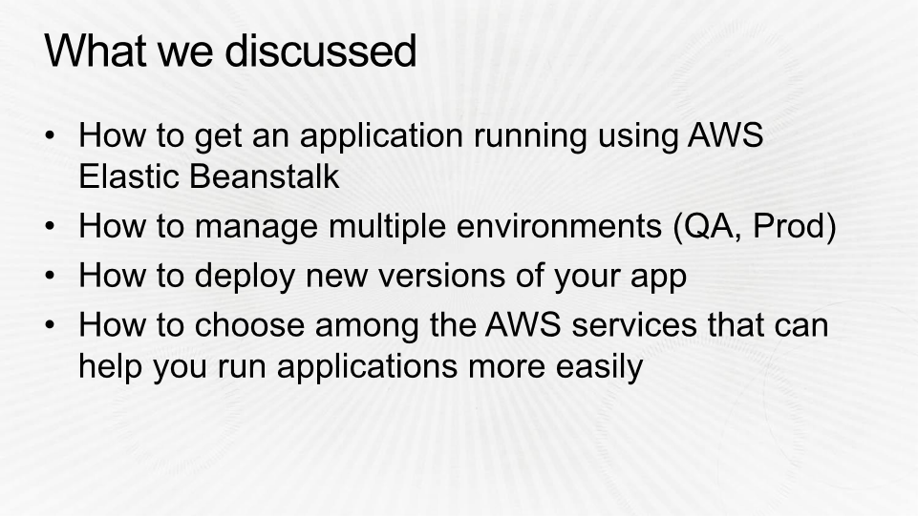

Slide 43
AWS CloudFormation
Reusable templates for automation

Slide 44
CloudFormation 101
What is CloudFormation
CloudFormation Template
Template Schema
Operations Supported
Resources Supported
Tools
CloudFormer
Gotachas
Scenarios
Links

Slide 45
What is CloudFormation ?
Service from AWS to aid faster infra setup & deployment
Easy way to Create / Update / Delete the infra stack
JSON based
No charge for CloudFormation service
Available in all the regions of AWS
Available for almost all AWS Services

Slide 46
Template Schema
{
“AWSTemplateFormatVersion” : “2010-09-09”,
“Description” : “My AWS Stack”,
“Parameters” : {
},
“Mapping” : {
},
“Resources” : {
},
“Output” : {
}
}
Mandatory

Slide 47
Operations Supported
Create New Stack
Update Stack
Delete Stack

Slide 48












AWS Resource Supported
Amazon EC2
CloudFront
CloudWatch
Amazon SQS
Elastic Load
Balancing
Amazon SNS
DynamoDB
ElastiCache
Elastic Beanstalk
Amazon S3
Amazon RDS
IAM

Slide 49
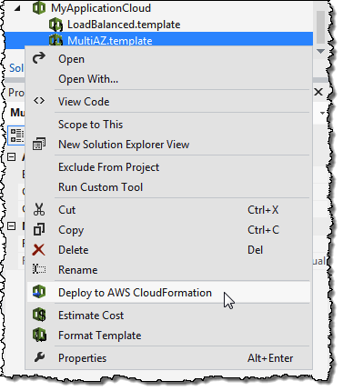
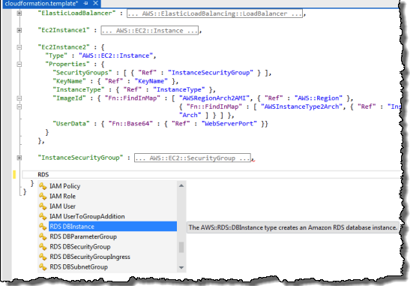


Tools
AWS CloudFormation template editors
Visual Studio
Eclipse

Slide 50
CloudFormer
The good and bad tool from AWS
Deploy a CloudFormer using a CloudFormation template → You get URL for EC2 instance
Running the EC2 instance shows you the entire AWS resources running in your subscription
Pick your stack components
Bam → the CloudFormation Template ready for your stack you developed manually
No parameters, No mappings, Only Hard Coded values

Slide 51
Gotchas (1/4)
Yes, CloudFormation is free but the underlying resources are charges at regular prices
There is no Sand-Box to test / try out
Unlimited Resources, but only 20 Parameters & 20 Output
Order of the Resources in the template doesn’t matter (AWS takes care), but fails sometimes. Logical to have the creation in required order for easy debugging and readability of the template

Slide 52
Gotcha (2/4)
Template is first uploaded to S3 and then deployed.
Can be generic at the level of Resources like AMI (using mappings).
Well formed (proper JSON) and well defined (EC2 can’t have S3’s parameters)
EC2 AMI must be in the same region, if not STACK DEPLOY ERROR will be reported

Slide 53
Gotcha (3/4)
Template is verified before deploying (any errors in JSON structure or AWS JSON semantics is taken care) and will forbid the deployment.
Dynamic error like (user has no permission to create S3 bucket) will fail at during deployment.
Failed deployments can be halted at error or rolled back

Slide 54
Gotcha (4/4)
App level dependencies like create DB first then create web server will be done via wait signal.
Init Scripts only available for Amazon Linux
Windows (open source) available, no support
Everything inside AWS is a resource including SG, GatewayAttachment, ElasticIPAttachment etc.

Slide 55
Scenario of Applicability of Cloud Formation
Write once, deploy several times and continue your work
Offload laborious work of building AWS infra stack every time ( set up Hadoop and run the MR, everyday for 2 hours)
Start for a REGION take it to other REGION with just replacing AMI and AZ
Have a library of templates for common / frequently deployed stacks.

Slide 56
Resources
http://aws.amazon.com/cloudformation/
http://docs.aws.amazon.com/AWSCloudFormation/latest/UserGuide/Welcome.html
http://aws.amazon.com/developertools/6460180344805680

